Slide 2
Tree (new ADT)
Terminology:
A tree is a collection of elements (nodes)
Each node may have 0 or more successors (called children)
How many does a list have?
Each node has exactly one predecessor (called the parent)
Except the starting node, called the root
Links from node to its successors are called branches
Nodes with same parent are siblings
Nodes with no children are called leaves

Slide 3
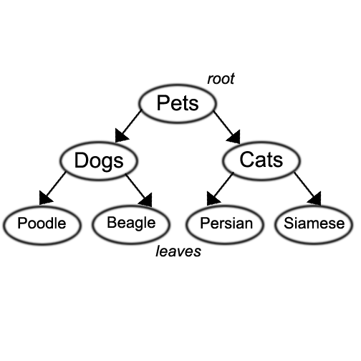
Tree
We also use words like ancestor and descendent
Pets is the parent of Dogs and Cats
Poodle and Beagle are the children of Dogs
Poodle, Beagle, Persian, and Siamese are descendents of Pets,
Pets is the ancestor of Poodle, Beagle, Persian, and Siamese

Slide 4
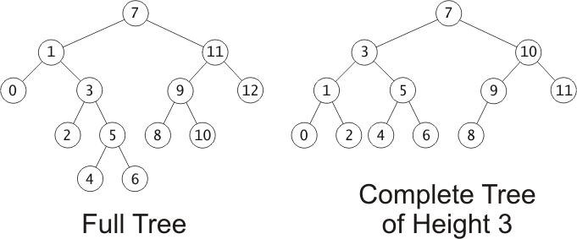
Tree Terminology
Subtree of a node:
A tree whose root is a child of that node
Depth of a node:
A measure of its distance from the root:
Depth of the root = 0
Depth of other nodes = 1 + depth of parent
1
2
3
4

Slide 5
Fullness and Completeness:
Trees grow from the top down
New values inserted in new leaf nodes
In a full tree, every node has 0 or 2 non-null children
A complete tree of height h is filled up to depth h-1, and, at depth h, any unfilled nodes are on the right.

Slide 6
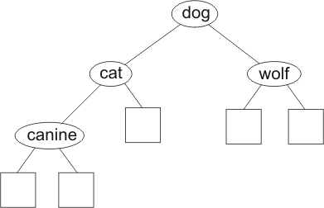
Binary Trees
Binary tree: a node has at most 2 nonempty subtrees
Set of nodes T is a binary tree if either of these is true:
T is empty
Root of T has two subtrees, both binary trees
(Notice that this is a recursive definition)
class Node {
string data;
node *left;
node *right;
};
This is a
binary tree

Slide 7
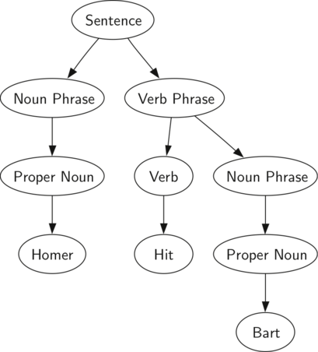
Example of binary tree:
Simple sentence parsing: used to model relationship between words in a sentence:
Used for topic determination
Learning tools
Language translation
Etc.

Slide 8
Huffman Coding
Huffman codes used to compress information
JPEGs (images) use Huffman as part of their compression process
Basic idea:
Store most frequently occurring info with a shorter representation than info that occurs less frequently.
E.g.,
Represent e with:010
Represent z with: 1100001010
Each file will be different, based on frequencies

Slide 9
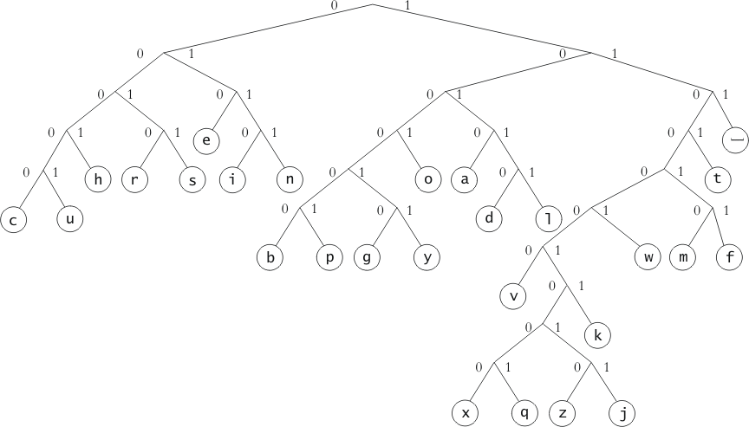
Examples: Huffman Binary Tree
Represents Huffman codes for characters appearing in a file or stream
Code may use different numbers of bits to encode different characters
Code for b = 1100000
Code for w = 1110001
Code for s = 10011
Code for e = 1010

Slide 10
Traversals of Binary Trees
Can walk the tree and visit all the nodes in the tree in order
This process is called tree traversal
Three kinds of binary tree traversal:
Preorder e.g., copying
Inorder – e.g., bst
Postorder –e.g., deleting or freeing nodes
order in which we visit the subtree root w.r.t. its children
Why do we worry about traversing in different orders?
Trees represent data – we may want to find or represent data in different ways depending on the data and the solution we are looking for

Slide 11
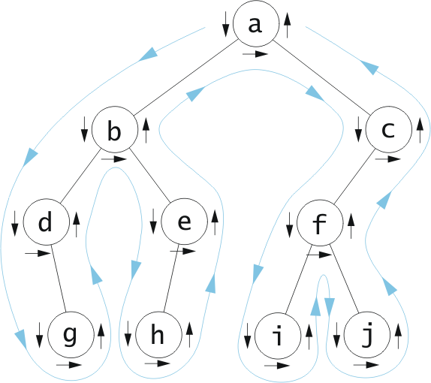
Tree Traversal: Preorder
Used for copying:
Visit root,
traverse left,
traverse right
Preorder:
a, b, d, g,e,h,
c, f, i, j

Slide 12
Tree Traversals: InOrder
Used for creating sorted list:
Traverse left (go till no more lefts),
visit root,
traverse right (always go to the left if there’s a left)
Inorder (left,
center, right)
d, g, b, h, e,
a, i, f, j, c

Slide 13
Tree Traversal: Postorder
Used for deleting:
Traverse left,
traverse right,
visit root
Postorder:
g, d, h, e, b,
i, j, f, c, a

Slide 14
Binary Tree Traversals
Preorder: Visit root, traverse left, traverse right
Inorder: Traverse left, visit root, traverse right
Postorder: Traverse left, traverse right, visit root

Slide 15
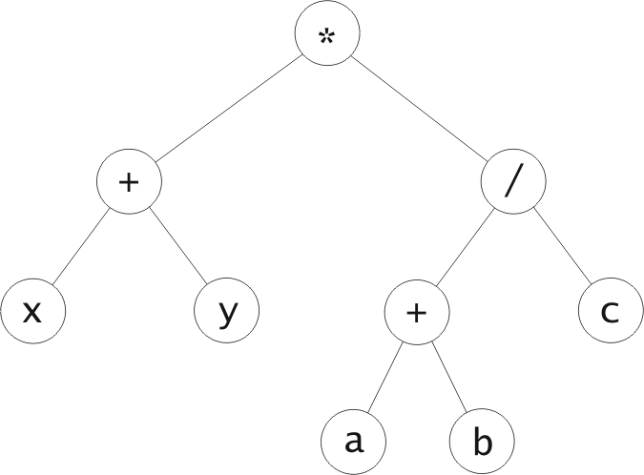
Traversals of Expression Trees
Equations: represents order of operation – we know we must do the lower subtrees before we can evaluate the higher level tree operations
Inorder traversal: results in infix form
Postorder traversal results in postfix form
Prefix traversal results in prefix form
Infix form (x + y) * ((a + b) / c)
Postfix form: x y + a b + c / *
Prefix form: * + x y / + a b c
Note: I added parentheses to make order
of operation clearer

Slide 16
Given this code, what is printed out?
void BST::printTreeio(NodeT *n) {
if (n == NULL) {
return;
}
else {
printTreeio(n->left);
n->printNode();
printTreeio(n->right);
}
}
36
16
48
15
21
40
11
23
44
41

Slide 17
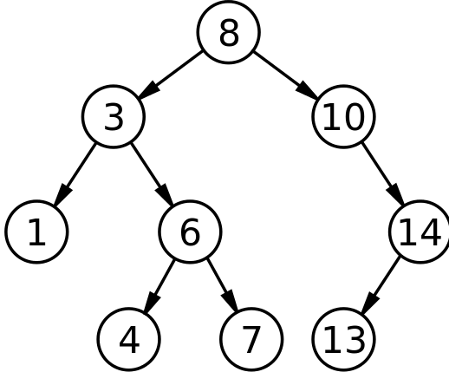
Binary Search Tree:
A tree in which the data in every left node is less than the data in its parent, and the data in the right node is greater than the data in its parent.
Inserting/Finding Data:
Data is inserted(found) by comparing the new data to the root
We move to either the left or the right child of the root depending on whether the data we’re looking for/inserting is less than or greater than the root.
The child, in essence, becomes the root of the subtree
the process continues until data is found or the child is null
if inserting, the data is inserted
If child is null and finding, data not in tree

Slide 18
Binary Search Tree
Inserting: 36, 16, 48,15, 21, 11, 23, 40, 44, 41
36
16
48
15
21
40
11
23
44
41

Slide 19
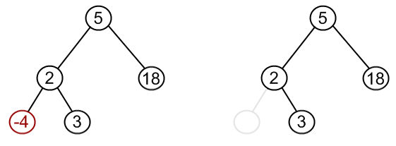
Removing: case 1
Search for node and then, if it’s in the tree, remove it.
3 cases:
Node to be removed has no children:
Just delete the node, and make the parent point to NULL (must keep track of parent)

Slide 20
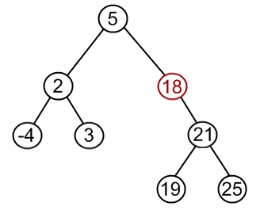
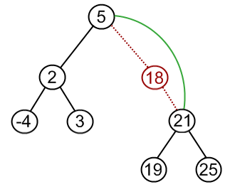
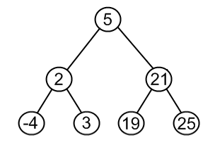
Removing: case 2
Node to remove has one child:
Parent points to node’s child
Delete node

Slide 21
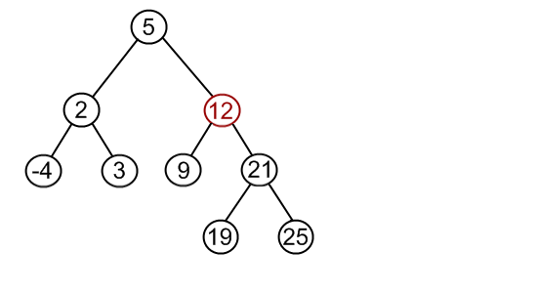
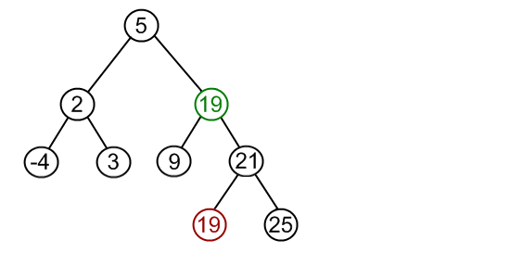
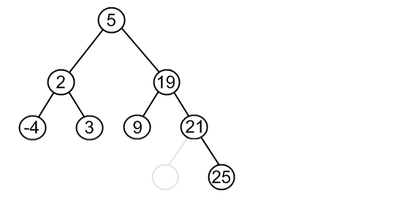
Removing: case 3
Node has 2 children.
Remember, we must maintain the BST properties when we remove a node
What if we want to remove 12 and we have the following tree:
7
10
7
10
7
10
Find the MINIMUM VALUE IN THE RIGHT SUBTREE
Replace the node with the value found
Remove the value from the right subtree
Is the tree still a binary search tree?
Notes:
Got here.

Slide 22
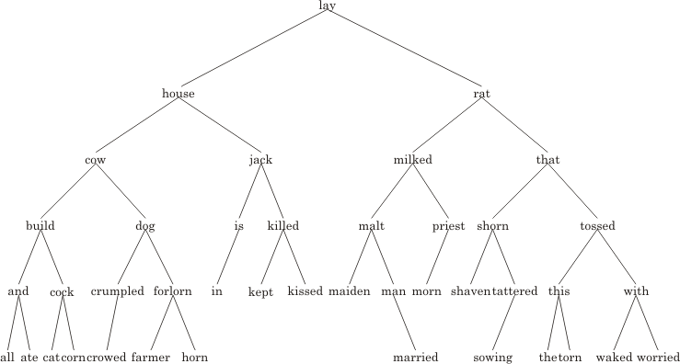
Remove rat from the tree

Slide 23
Remove rat from the tree
shaven

